Slide 1
Software Development Lifecycle
(SDLC)

Slide 2
Software Lifecycle Activities
...and their models
Requirements
Elicitation
Analysis
System
Design
Object
Design
Implemen-
tation
Testing
Implemented
By
Expressed in Terms Of
Structured By
Realized By
Verified
By
class...
class...
class...
?
class....
?
Use Case
Model
Application
Domain
Objects
Solution Domain
Objects
Subsystems
Source
Code
Test
Cases

Slide 3
Software Lifecycle Activities
Requirements Analysis
What is the problem?
Application
Domain
System Design
What is the solution?
What are the best mechanisms
Detailed Design
to implement the solution?
Solution
Domain
Program Implementation
How is the solution
constructed?
Testing
Is the problem solved?
Delivery
Can the customer use the solution?
Maintenance
Are enhancements needed?

Slide 4
Software Lifecycle Definition
Software lifecycle:
  Set of activities and their relationships to each other to support the development of a software system
Typical Lifecycle questions:
  Which activities should I select for the software project?
  What are the dependencies between activities?
  How should I schedule the activities?

Slide 5
SDLC Model
A framework that describes the activities performed at each stage of a software development project.

Slide 6
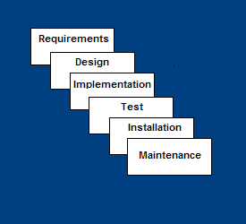
Waterfall Model
Requirements – defines needed information, function, behavior, performance and interfaces
Design – data structures, software architecture, interface representations, algorithmic details
Implementation – source code, database, user documentation, testing

Slide 7
Waterfall Strengths
Easy to understand, easy to use
Provides structure to inexperienced staff
Milestones are well understood
Sets requirements stability
Good for management control (plan, staff, track)
Works well when quality is more important than cost or schedule

Slide 8
Waterfall Deficiencies
All requirements must be known upfront
Deliverables created for each phase are considered frozen – inhibits flexibility
Can give a false impression of progress
Does not reflect problem-solving nature of software development – iterations of phases
Integration is one big bang at the end
Little opportunity for customer to preview the system (until it may be too late)

Slide 9
When to use the Waterfall Model
Requirements are very well known
Product definition is stable
Technology is understood
New version of an existing product
Porting an existing product to a new platform.

Slide 10
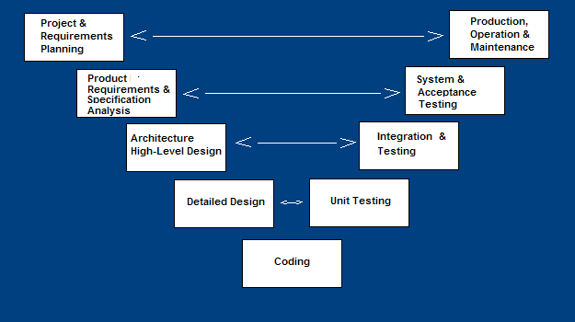
V-Shaped SDLC Model
A variant of the Waterfall that emphasizes the verification and validation of the product.
Testing of the product is planned in parallel with a corresponding phase of development

Slide 11
V-Shaped Steps
Project and Requirements Planning – allocate resources
Product Requirements and Specification Analysis – complete specification of the software system
Architecture or High-Level Design – defines how software functions fulfill the design
Detailed Design – develop algorithms for each architectural component
Production, operation and maintenance – provide for enhancement and corrections
System and acceptance testing – check the entire software system in its environment
Integration and Testing – check that modules interconnect correctly
Unit testing – check that each module acts as expected
Coding – transform algorithms into software

Slide 12
V-Shaped Strengths
Emphasize planning for verification and validation of the product in early stages of product development
Each deliverable must be testable
Project management can track progress by milestones
Easy to use

Slide 13
V-Shaped Weaknesses
Does not easily handle concurrent events
Does not handle iterations or phases
Does not easily handle dynamic changes in requirements
Does not contain risk analysis activities

Slide 14
When to use the V-Shaped Model
Excellent choice for systems requiring high reliability – hospital patient control applications
All requirements are known up-front
When it can be modified to handle changing requirements beyond analysis phase
Solution and technology are known

Slide 15
Structured Evolutionary Prototyping Model
Developers build a prototype during the requirements phase
Prototype is evaluated by end users
Users give corrective feedback
Developers further refine the prototype
When the user is satisfied, the prototype code is brought up to the standards needed for a final product.

Slide 16
Structured Evolutionary Prototyping Steps
A preliminary project plan is developed
A partial high-level paper model is created
The model is source for a partial requirements specification
A prototype is built with basic and critical attributes
The designer builds
  the database
  user interface
  algorithmic functions
The designer demonstrates the prototype, the user evaluates for problems and suggests improvements.
This loop continues until the user is satisfied

Slide 17
Structured Evolutionary Prototyping Strengths
Customers can “see” the system requirements as they are being gathered
Developers learn from customers
A more accurate end product
Unexpected requirements accommodated
Allows for flexible design and development
Steady, visible signs of progress produced
Interaction with the prototype stimulates awareness of additional needed functionality

Slide 18
Structured Evolutionary Prototyping Weaknesses
Tendency to abandon structured program development for “code-and-fix” development
Bad reputation for “quick-and-dirty” methods
Overall maintainability may be overlooked
The customer may want the prototype delivered.
Process may continue forever

Slide 19
When to use Structured Evolutionary Prototyping
Requirements are unstable or have to be clarified
As the requirements clarification stage of a waterfall model
Develop user interfaces
Short-lived demonstrations
New, original development
With the analysis and design portions of object-oriented development

Slide 20
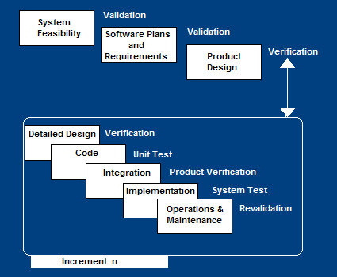
Incremental SDLC Model
Construct a partial implementation of a total system
Then slowly add increased functionality
The incremental model prioritizes requirements of the system and then implements them in groups.
Each subsequent release of the system adds function to the previous release, until all designed functionality has been implemented.

Slide 21
Incremental Model Strengths
Develop high-risk or major functions first
Each release delivers an operational product
Customer can respond to each build
Uses “divide and conquer” breakdown of tasks
Lowers initial delivery cost
Initial product delivery is faster
Customers get important functionality early
Risk of changing requirements is reduced

Slide 22
Incremental Model Weaknesses
Requires good planning and design
Requires early definition of a complete and fully functional system to allow for the definition of increments
Well-defined module interfaces are required (some will be developed long before others)
Total cost of the complete system is not lower

Slide 23
When to use the Incremental Model
Risk, funding, schedule, program complexity, or need for early realization of benefits.
Most of the requirements are known up-front but are expected to evolve over time
A need to get basic functionality to the market early
On projects which have lengthy development schedules
On a project with new technology

Slide 24
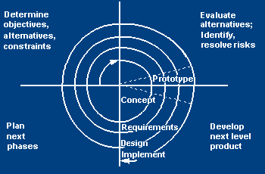
Spiral SDLC Model
Adds risk analysis, and RAD prototyping to the waterfall model
Each cycle involves the same sequence of steps as the waterfall process model

Slide 25
Spiral Quadrant
Determine objectives, alternatives and constraints
Objectives:
  functionality, performance, hardware/software interface, critical success factors, etc.
Alternatives:
  build, reuse, buy, sub-contract, etc.
Constraints:
  cost, schedule, interface, etc.

Slide 26
Spiral Quadrant
Evaluate alternatives, identify and resolve risks
Study alternatives relative to objectives and constraints
Identify risks (lack of experience, new technology, tight schedules, poor process, etc.
Resolve risks (evaluate if money could be lost by continuing system development

Slide 27
Spiral Quadrant
Develop next-level product
Typical activites:
  Create a design
  Review design
  Develop code
  Inspect code
  Test product

Slide 28
Spiral Quadrant
Plan next phase
Typical activities
  Develop project plan
  Develop configuration management plan
  Develop a test plan
  Develop an installation plan

Slide 29
Spiral Model Strengths
Provides early indication of insurmountable risks, without much cost
Users see the system early because of rapid prototyping tools
Critical high-risk functions are developed first
The design does not have to be perfect
Users can be closely tied to all lifecycle steps
Early and frequent feedback from users
Cumulative costs assessed frequently

Slide 30
Spiral Model Weaknesses
Time spent for evaluating risks too large for small or low-risk projects
Time spent planning, resetting objectives, doing risk analysis and prototyping may be excessive
The model is complex
Risk assessment expertise is required
Spiral may continue indefinitely
Developers must be reassigned during non-development phase activities
May be hard to define objective, verifiable milestones that indicate readiness to proceed through the next iteration

Slide 31
When to use Spiral Model
When creation of a prototype is appropriate
When costs and risk evaluation is important
For medium to high-risk projects
Long-term project commitment unwise because of potential changes to economic priorities
Users are unsure of their needs
Requirements are complex
New product line
Significant changes are expected (research and exploration)

Slide 32
Agile SDLC’s
Speed up or bypass one or more life cycle phases
Usually less formal and reduced scope
Used for time-critical applications
Used in organizations that employ disciplined methods

Slide 33
Some Agile Methods
Adaptive Software Development (ASD)
Feature Driven Development (FDD)
Crystal Clear
Dynamic Software Development Method (DSDM)
Rapid Application Development (RAD)
Scrum
Extreme Programming (XP)
Rational Unified Process (RUP)

Slide 34
Extreme Programming - XP
For small-to-medium-sized teams developing software with vague or rapidly changing requirements
Coding is the key activity throughout a software project
Communication among teammates is done with code
Life cycle and behavior of complex objects defined in test cases – again in code

Slide 35
XP is “extreme” because
Commonsense practices taken to extreme levels
If code reviews are good, review code all the time (pair programming)
If testing is good, everybody will test all the time
If simplicity is good, keep the system in the simplest design that supports its current functionality (simplest thing that works)
If design is good, everybody will design daily (refactoring)
If architecture is important, everybody will work at defining and refining the architecture (metaphor)
If integration testing is important, build and integrate test several times a day (continuous integration)
If short iterations are good, make iterations really, really short (hours rather than weeks)

Slide 36
XP Practices (12 Principles)
Planning game – determine scope of the next release by combining business priorities and technical estimates
Small releases – put a simple system into production, then release new versions in very short cycle
Metaphor – all development is guided by a simple shared story of how the whole system works
Simple design – system is designed as simply as possible (extra complexity removed as soon as found)
Testing – programmers continuously write unit tests; customers write tests for features
Refactoring – programmers continuously restructure the system without changing its behavior to remove duplication and simplify

Slide 37
XP Practices (12 Principles)
Pair-programming -- all production code is written with two programmers at one machine
Collective ownership – anyone can change any code anywhere in the system at any time
Continuous integration – integrate and build the system many times a day – every time a task is completed
40-hour week – work no more than 40 hours a week as a rule
On-site customer – a user is on the team and available full-time to answer questions
Coding standards – programmers write all code in accordance with rules emphasizing communication through the code

Slide 38
Rapid Application Model (RAD)
Requirements planning phase (a workshop utilizing structured discussion of business problems)
User description phase – automated tools capture information from users
Construction phase – productivity tools, such as code generators, screen generators, etc. inside a time-box
Cutover phase -- installation of the system, user acceptance testing and user training

Slide 39
RAD Strengths
Reduced cycle time and improved productivity with fewer people means lower costs
Time-box approach mitigates cost and schedule risk
Customer involved throughout the complete cycle minimizes risk of not achieving customer satisfaction and business needs
Focus moves from documentation to code (WYSIWYG).
Uses modeling concepts to capture information about business, data, and processes.

Slide 40
RAD Weaknesses
Accelerated development process must give quick responses to the user
Risk of never achieving closure
Hard to use with legacy systems
Requires a system that can be modularized
Developers and customers must be committed to rapid-fire activities in an abbreviated time frame.

Slide 41
When to use RAD
Reasonably well-known requirements
User involved throughout the life cycle
Project can be time-boxed
Functionality delivered in increments
High performance not required
Low technical risks
System can be modularized

Slide 42

Phases in the Rational Unified Process

Slide 43
RUP phases
Inception
  Establish the business case for the system.
Elaboration
  Develop an understanding of the problem domain and the system architecture.
Construction
  System design, programming and testing.
Transition
  Deploy the system in its operating environment.

Slide 44
RUP iteration
In-phase iteration
  Each phase is iterative with results developed incrementally.
Cross-phase iteration
  As shown by the loop in the RUP model, the whole set of phases may be enacted incrementally.

